Slide 1
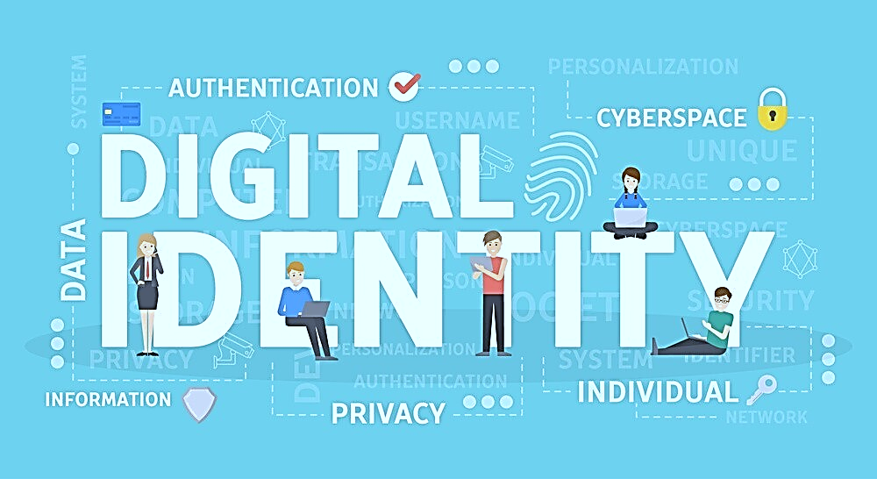
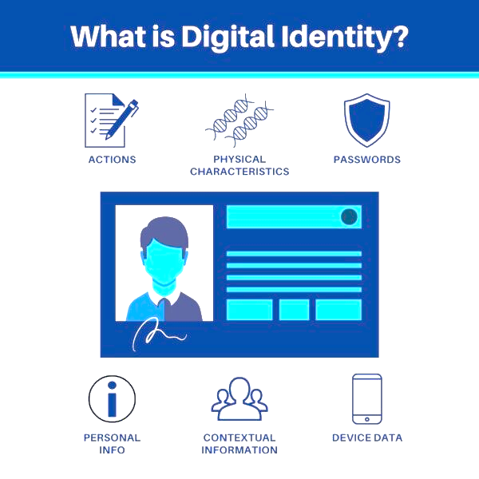

Slide 2
Digital Identity refers to representing an individual's identity in the digital realm. It encompasses collecting personal information, attributes, and credentials associated with an individual in the online space. A digital identity serves as a virtual representation of an individual's real-world identity, often used for online authentication, access to services, and participation in digital transactions.
Digital Identity

Slide 3
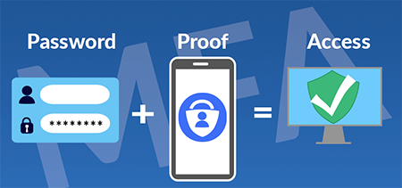
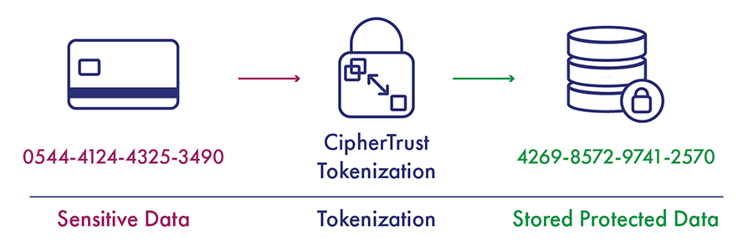
Key Components
Multi-Factor Authentication (MFA) involves combining multiple factors (e.g., passwords, biometrics, one-time codes) for user authentication.
Example: Logging into an online account requires both a password and a fingerprint scan, adding an extra layer of security.
Tokenization replaces sensitive data with unique tokens to enhance security and prevent unauthorized access.
Example: Credit card tokenization, where the actual card details are replaced with a unique token for secure transactions.

Slide 4
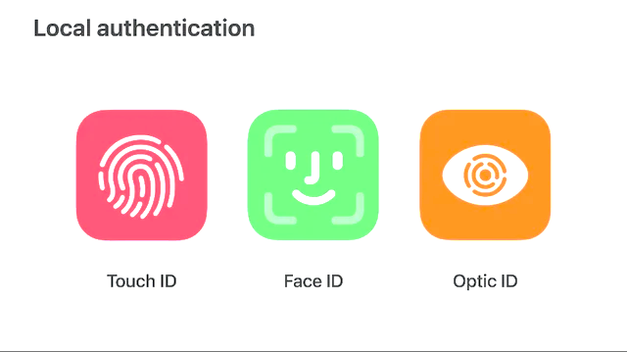
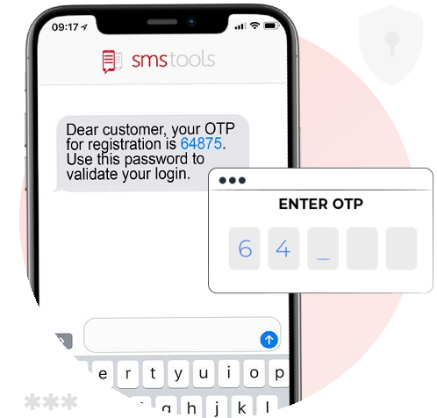
Key Components
Device Fingerprints capture unique characteristics of a device's hardware and settings for identification.
Example: Apple's Touch ID or Face ID, where the unique features of an iPhone or iPad are used for user authentication.
One-Time Passwords (OTP) are time-sensitive codes generated on-the-fly for authentication.
Example: Receiving a temporary code on a mobile device that must be entered during login to verify the user's identity.

Slide 5
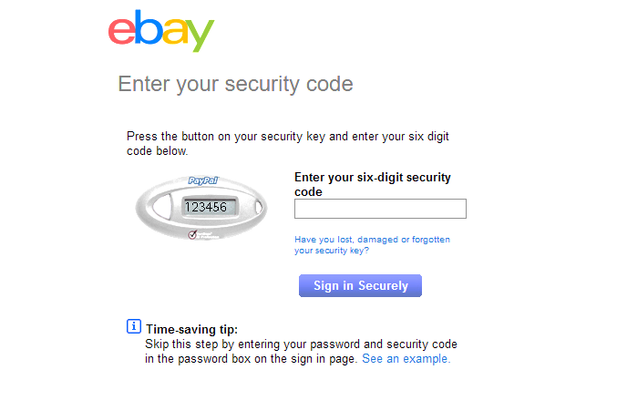

Key Components
Randomized Access Codes access codes are used for secure entry or transaction verification.
Example: Generating a unique and unpredictable access code sent to a user's email for secure login.
Blockchain-Based Identifiers identifiers, like Decentralized Identifiers (DIDs), offer a unique and secure way to manage digital identities.
Example: Storing verifiable credentials on a blockchain to provide a tamper-resistant and decentralized identity management solution.

Slide 6
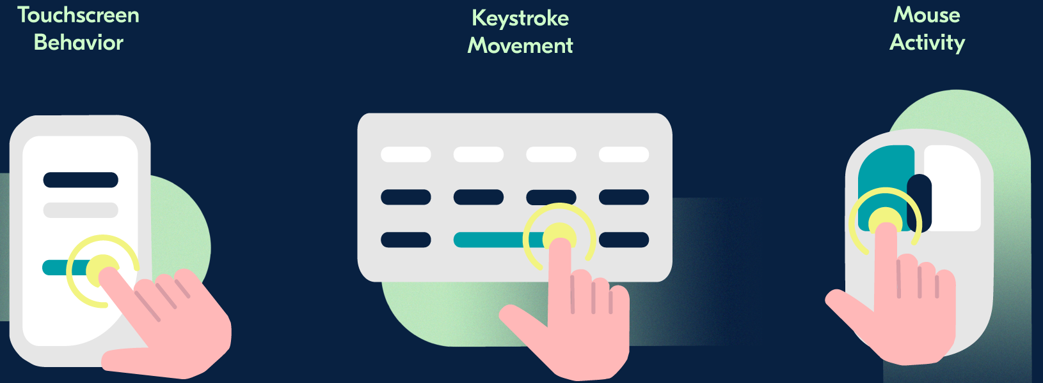
Key Components
Behavioral Biometrics analyze patterns of user behavior for identity verification.
Example: Keystroke dynamics, where the unique typing speed and rhythm of an individual are used for authentication.

Slide 7
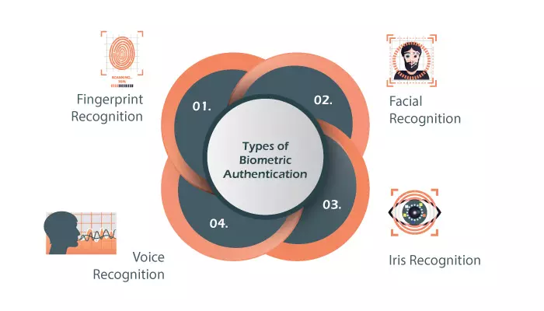
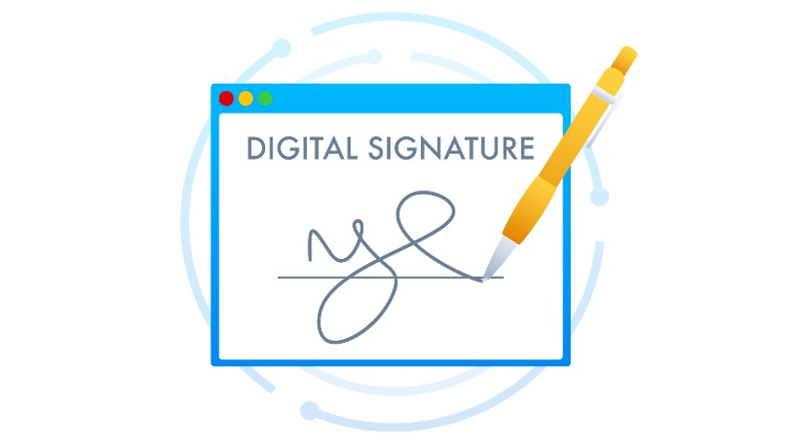
Key Components
Biometric Data consists of unique physical or behavioral characteristics of an individual used for identification.
Example: Fingerprint recognition technology, where the unique patterns of ridges and valleys on an individual's fingertips serve as a distinct biometric identifier.
Digital signatures use cryptographic algorithms to generate unique identifiers for verifying the authenticity and integrity of digital messages.
Example: Signing a document electronically using a private cryptographic key to ensure that the signature is unique to the signer and the document has not been altered.

Slide 8
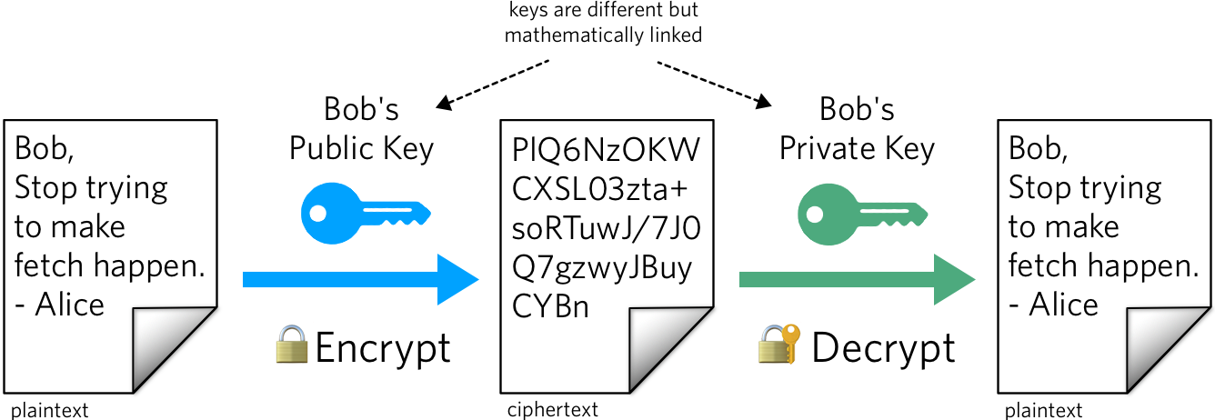
Key Components
Cryptographic Keys Public and private keys in asymmetric cryptography are used for secure communication, where each key pair is extremely difficult to replicate.
Example: Using Rivest-Shamir-Adleman (RSA) algorithm, a public key can encrypt information, and only the corresponding private key can decrypt it, ensuring secure communication.
Notes:
Rivest-Shamir-Adleman (RSA) algorithm: A public-key cryptography algorithm that uses a private and public key pair to encrypt and decrypt data. RSA is one of the oldest and most widely used algorithms for secure data transmission. The algorithm was developed by Ron Rivest, Adi Shamir, and Leonard Adleman, and was first published in 1977. RSA is used in many products and services, and is especially useful for sending sensitive information over the internet.

Slide 9
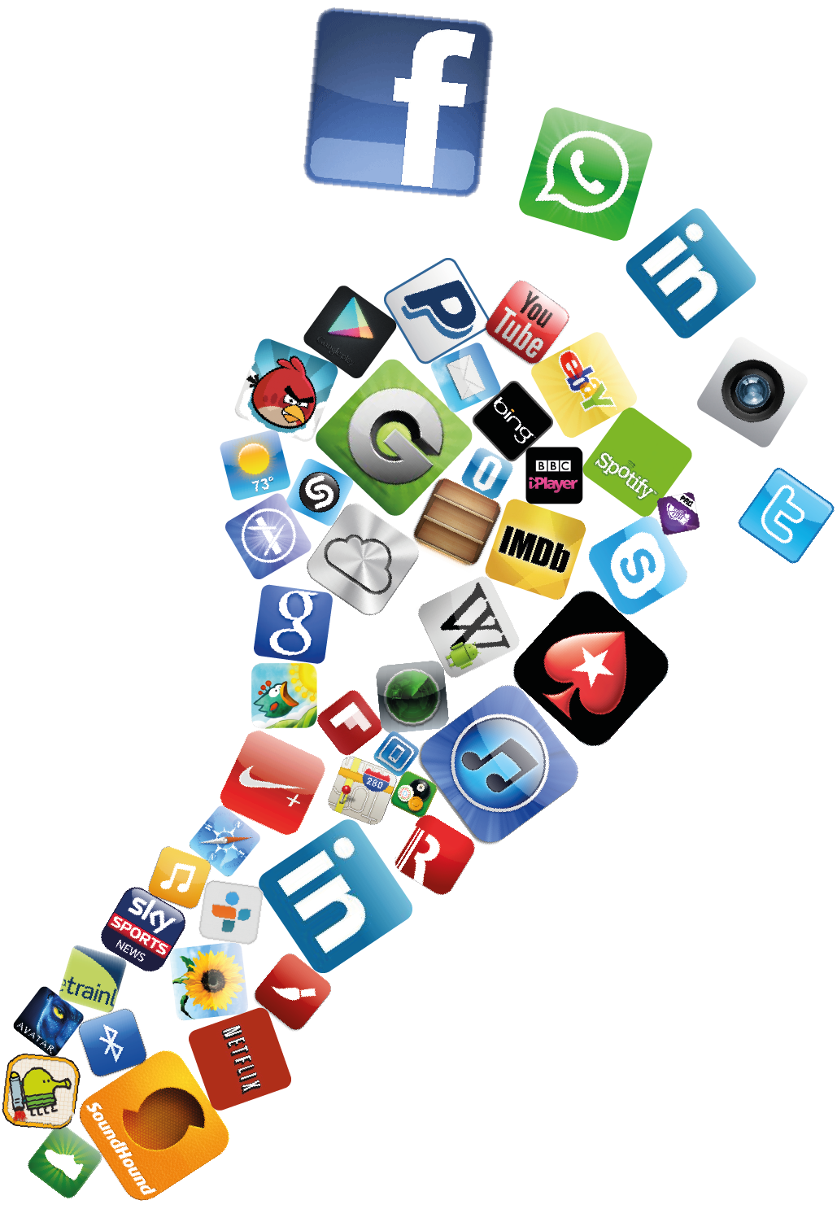
Digital Footprint
A digital footprint refers to the trail of data and information left behind by an individual's online activities. It is the digital record of interactions, transactions, and engagements across various online platforms and services. This footprint is created through the voluntary or involuntary sharing of personal information, content creation, online searches, and interactions with websites, applications, and social media.
Notes:
A digital footprint, sometimes called a “digital shadow,” is the unique trail of data that a person or business creates while using the internet. Nearly every online activity leaves a trace. Some traces are obvious, like a public social media post.

Slide 10
Components of a Digital Footprint
Social Media Activity: The information shared, liked, or commented on social media platforms.
Example: Facebook posts, tweets, Instagram photos, and comments contribute to an individual's social media activity within their digital footprint.
Online Searches: The record of searches made on search engines and the subsequent websites visited.
Example: Google searches, Bing searches, and the websites visited as a result of those searches contribute to the online search component of a digital footprint.
Website Cookies and Tracking: Data stored by websites to track user activity and preferences.
Example: Cookies store information about a user's preferences, login status, and browsing history on a particular website.

Slide 11
Components of a Digital Footprint
Location Data: Information about an individual's physical location obtained through GPS, Wi-Fi, or mobile networks.
Example: Location data recorded when using navigation apps, checking in on social media, or enabling location services on mobile devices.
Content Creation: The digital content an individual produces and shares online.
Example: Blog posts, videos on YouTube, articles published, or any other content created and published on the internet.
Online Profiles and Accounts: Information stored in profiles on various online platforms.
Example: User profiles on social media, professional networking sites, and other online services contribute to an individual's digital footprint.

Slide 12
How Digital Footprints Work
Data Collection:
Various online activities generate data that is collected and stored by websites, applications, and service providers.
Storage and Analysis:
The collected data is stored in databases, and sophisticated algorithms may be used to analyze patterns, preferences, and behaviors.
Profiling and Targeting:
Advertisers and service providers may use the digital footprint to create user profiles and target personalized content, advertisements, or recommendations.

Slide 13
How Digital Footprints Work
Digital Traces:
Every action, interaction, or transaction online leaves a trace, contributing to the ongoing development of an individual's digital footprint.
Impact on Privacy:
The cumulative data within a digital footprint can impact user privacy, and individuals need to be mindful of the information they share online.

Slide 14
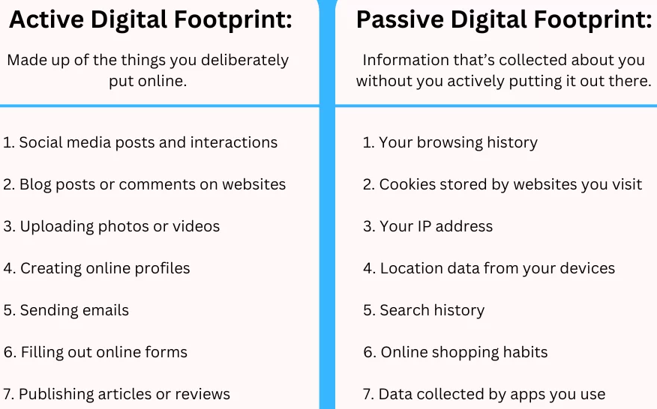
2 Types of Digital Footprints

Slide 15

Online Reputation
Online reputation is the public perception of a person or organization based on their online presence. It's made up of the content they create and share, how they interact with others online, and what others say about them.
Digital identity plays a significant role in shaping their online reputation. As individuals engage in various online activities, their digital footprint contributes to the formation of a virtual identity, which, in turn, influences how they are perceived by others.

Slide 16
Tips for improving your online reputation
Online Presence and Visibility
Positive Impact: A well-managed digital identity can enhance online presence, making individuals more visible and accessible in a professional or personal context.
Negative Impact: Inconsistent or controversial online behavior can diminish online visibility and negatively affect reputation.
Professional Branding
Positive Impact: A carefully curated digital identity can serve as a professional brand, showcasing skills, achievements, and expertise.
Negative Impact: Unprofessional content or associations online may damage one's professional branding and credibility.

Slide 17
Tips for improving your online reputation
Social Media Representation
Positive Impact: Active and positive engagement on social media platforms can build a favorable public image.
Negative Impact: Inappropriate or offensive content on social media can lead to a damaged reputation.
Trust and Credibility
Positive Impact: A consistent and trustworthy digital identity fosters credibility, both personally and professionally.
Negative Impact: Misleading information or inconsistent representations erode trust and credibility.

Slide 18
Tips for improving your online reputation
Employability and Networking
Positive Impact: A positive digital identity can contribute to career opportunities, networking, and job prospects.
Negative Impact: Employers and professional contacts may be deterred by negative online content, affecting career advancement.
Online Reviews and Feedback
Positive Impact: Positive reviews and constructive feedback contribute to a positive online reputation.
Negative Impact: Negative reviews or controversial comments can harm an individual's reputation.

Slide 19
Tips for improving your online reputation
Personal Relationships
Positive Impact: A positive digital identity can strengthen personal relationships by showcasing shared interests, values, and experiences.
Negative Impact: Negative or inappropriate online behavior may strain personal relationships and lead to misunderstandings.
Global Reach
Positive Impact: Digital identity allows individuals to connect with a global audience, expanding opportunities and collaborations.
Negative Impact: Inappropriate content can have a global impact, potentially reaching a wide audience and causing reputational damage.

